Slide 1

Typing Speed Test
Made by Shafiuddin Seyam
A desktop GUI application built with Python and Tkinter, designed to test typing speed, accuracy, and track progress over time.

Slide 2

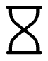



Key Features
Unlocking Your Typing Potential
Timed Challenges
Dynamic Content
Engage in 1-minute countdown typing sessions to test your speed under pressure.
Access a diverse library of random paragraphs to ensure varied and engaging practice.
Instant Feedback
Performance Insights
Monitor real-time accuracy and receive immediate error highlighting for quick correction.
Review detailed reports on typing speed and accuracy, with high score tracking for continuous improvement.

Slide 3
Technology & Requirements
Built for Simplicity and Accessibility
Core Technologies
Project Structure
Python 3.13.5 : The robust and versatile programming language at its foundation.
typing_speed_test.py: The main application script.
typing_results.csv: Stores your comprehensive test results.
Tkinter: Python's standard GUI toolkit, enabling a native desktop experience.
high_score.txt: Records your top Words Per Minute (WPM).
Built-in Modules: Ensures zero external dependencies for easy deployment.

Slide 4
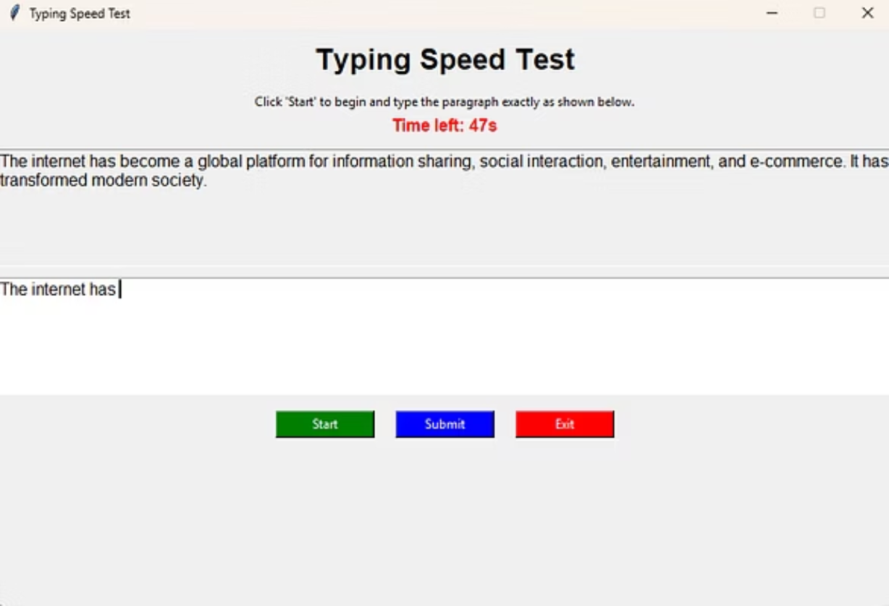
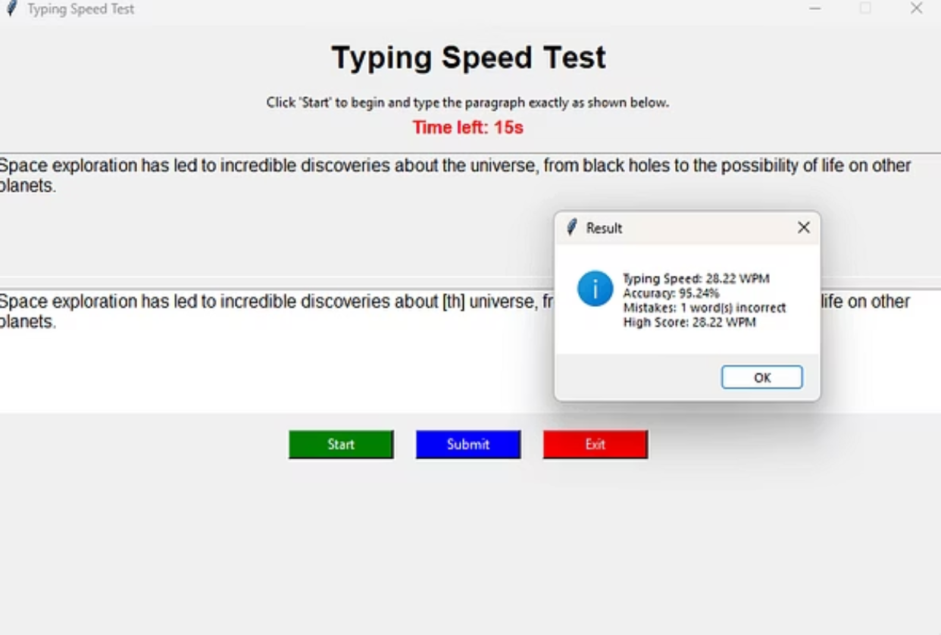
App in Action
A Glimpse of the Interface
Explore the intuitive design and real-time feedback that make the Typing Speed Test both efficient and engaging.

Slide 5
Get Started
Run It on Any OS
Launch the Application
Navigate to Directory
python typing_speed_test.py
Clone the Repository
cd typing-speed-test
Execute the main Python script to open the GUI application.
git clone https://github.com/YOUR_USERNAME/typing-speed-test.git
Change to the project directory to access the application files.
Download the project files to your local machine.
Enjoy a seamless setup process and start improving your typing skills instantly!

